Slide 1
A Review of Math Descriptive Statistics Probability
A Little Bit of Everything

Slide 2

Sigma Notation: Summation
∑ (the Greek letter ‘sigma’) is the symbol for summation
Assume we have 5 numbers, which we call x₁, x₂, x₃, x₄, and x₅ (let’s say x₁ = 3, x₂ = 6, x₃ = 0, x₄ = -3, and x₅ = 8)
How do we write the sum of these 5 numbers?
x₁ + x₂ + x₃ + x₄ + x₅ = = 3 + 6 + 0 + (-3) + 8 = 14
That is, for all subscripts i ranging from 1 to 5, we sum the x’s.
For some excellent examples on sigma notation for summation, please see http://www.regentsprep.org/Regents/math/algtrig/ATP1b/SigmaNotation.htm
$$\sum_{i=1}^{5}{x_{i}}$$

Slide 3
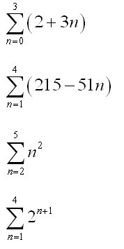
Deciphering Sigma Notation: Examples
(2+3*0) + (2+3*1) + (2+3*2) + (2+3*3)
(215-51*1) + (215-51*2) + (215-51*3) + (215-51*4)
2² + 3² + 4² + 5²
2² + 2³ + 2⁴ + 2⁵

Slide 4
Factorials
For any integer n ≥ 0, n! = n*(n-1)*(n-2)*…*1
For example, 4! = 4*3*2*1=24
n! is pronounced ‘n factorial’
1! and 0! are by definition equal to 1

Slide 5
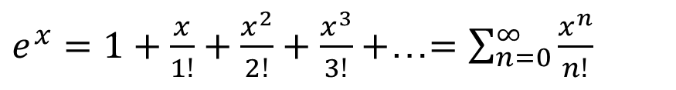
Exponentiation
a^{x}
a is the ‘base’; x is the ‘exponent’.
x is the number of times to multiply a by itself
e^{x} = exp(x)
e, known as Euler’s constant, shows up in numerous mathematical formulas – from calculus to probability
e^{x} is defined as in the formula below.
When x=1, e=1+1/1+1/2+1/6+1/24+1/120+… =2.71828
$e^{x}=1+\frac{x}{1!}+\frac{x^{2}}{2!}+\frac{x^{3}}{3!}+$…$=\sum_{n=0}^{∞}{\frac{x^{n}}{n!}}$

Slide 6
Examples
2⁴ = 2*2*2*2=16
100^{0.5} = √100 = 10 (or -10) (fraction exponent)
10⁻² = 1/ 10² = 0.01 (- exponent)
2^{4 *} 2⁵ = 2⁽⁴⁺⁵⁾ =2⁹ (Same base; mult.)
3⁸ / 3⁵ = 3⁽⁸⁻⁵⁾ =3³ (Same base; division)
a⁰ = 1 (for any a)

Slide 7
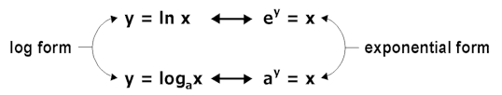

Logarithms – Exponentiation Reversed
Logarithms are the opposite of exponentiation.
Here, b>0 (not equal to 1) and x>0.
Assume we have a problem: 3.21^{y} = 61. Find y.
Here, x=61, base b=3.21 and we want to find y. We can rewrite it as y=log_{3.21}61. Any calculator or mathematically oriented software package, like Excel, will solve this problem.
$$if x=b^{y}, then y=\log_{b}(x)$$
Source: http://library.thinkquest.org/20991/alg2/log.html

Slide 8
Logarithms – Special Cases
There are two special cases of logarithms, when the bases (b) are equal to 10 or e. These are the cases that we will examine for this course.
Assume we have a problem which is written as log 1000. Here, the base b is omitted.
This assumes that the base is 10, and it is equivalent to writing this as y=log₁₀1000 (or as 1000=10^{y}).
When the base is e, we have what is called a ‘natural logarithm’, denoted by ln.
So a problem where we have ln 1000 can be rewritten as log_{e}1000 = log_{2.72}1000. This, in turn, can be rewritten as or as 1000=e^{y}, or 1000=2.72^{y}
Unfortunately, when some statisticians write log x, they actually mean ln x, violating the standard notation. But the good thing is that for our intents and purposes it won’t matter in most instances.
We will use logarithms when we get to regression analysis to make the distribution of a skewed variable more normal: more on that later in the course.

Slide 9
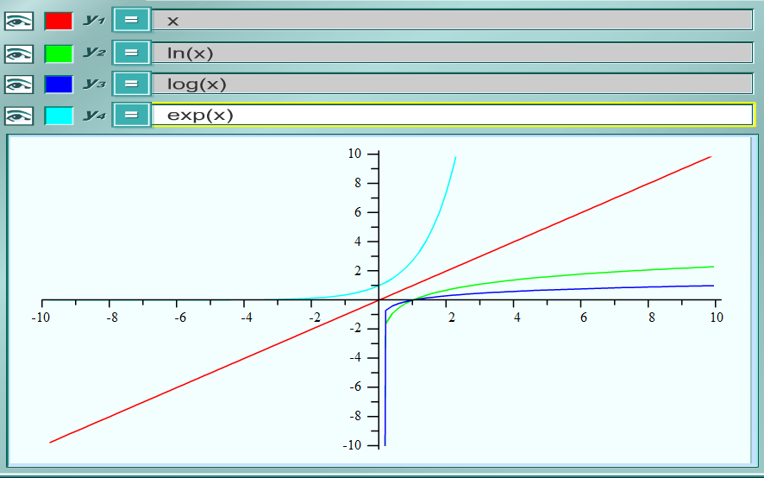
Plotting Logarithms and Exponential Functions
For x>1, y₁=x is greater than y₂=ln(x) and y₃=log(x)
Source: http://my.hrw.com/math06_07/nsmedia/tools/Graph_Calculator/graphCalc.html

Slide 10
A Few Other Things to Note
Abbreviations:
iff = if and only if
s.t. = such that
x≤y = x is less than or equal to y
x≥y = x is greater than or equal to y
Δ = Greek letter delta, means change
∃ = there exists
∀ = for all (or for every)
Typing formulas and equations in MS Word

Slide 11
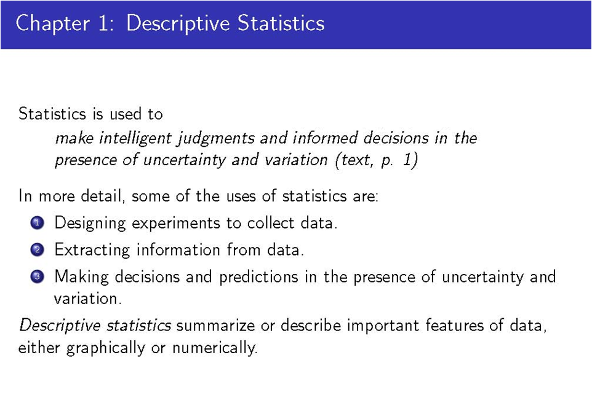
Notes:
You design an RCT to test effectiveness of a new flu drug where half the people are in the experimental group and half in the control; how many people do you need for the study?
What is the average duration of the flu in both groups? What is the median duration of the flu?
Can you then go ahead and say that this new drug will be more effective for the general population?

Slide 12
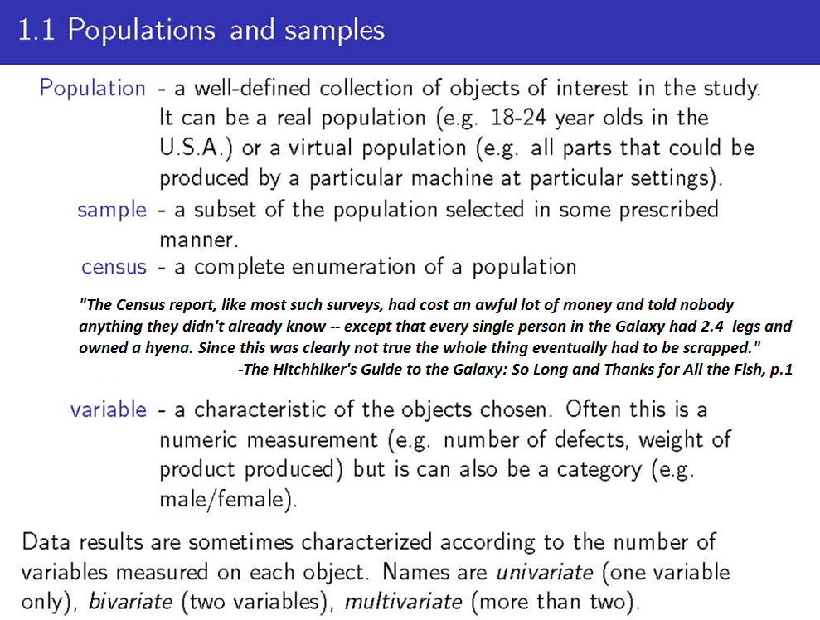
Notes:
Virtual population: all housing units that could be built in a state if certain policies were passed.

Slide 13
Discrete vs. Continuous Data
A variable is discrete if its set of possible values is finite or one in which there is a first number, a second number, and so on. In practice, the set of values is typically small.
A count variable (typically with small number of possible values – e.g., # missing students)
A binary variable (aka dichotomous variable, aka dummy) is a discrete variable which has two values only – (true/false, yes/no)
A categorical variable is one which has several categories (race; transportation type)
An ordinal variable is one with an ordered set of values (e.g., ratings on a 3 point scale)
How important is education to you? (1=Not at all, 2=Somewhat, 3=Very). Here 3 means more important than 1.
A variable is continuous if its possible values consist of an entire interval on the number line
Temperature or Air Pressure
Weight or Height
National Deficit or Income

Slide 14
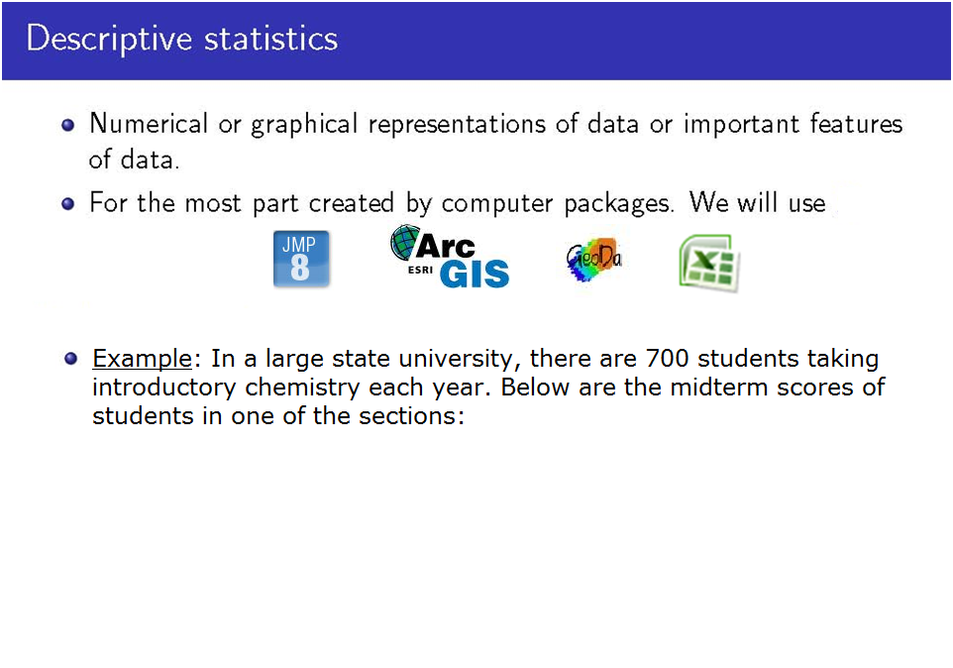
84 49 61 40 83 67 46 66 70 69
80 58 68 60 67 72 73 70 57 63
70 78 52 67 53 67 75 61 70 81
76 79 75 76 58 31

Slide 15
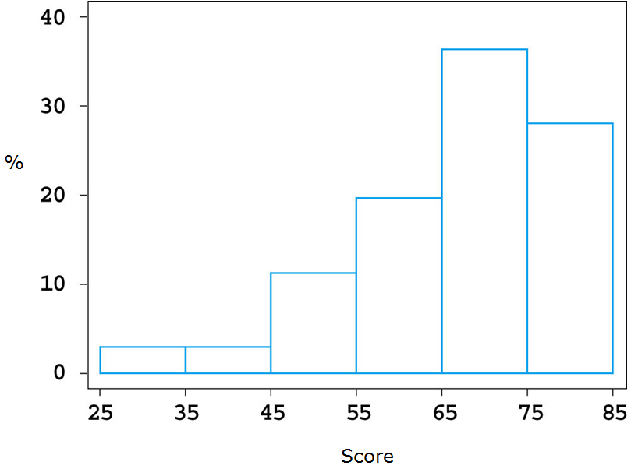
Chemistry Example: Histogram and Summary Statistics
31 | 68
40 | 69
46 | 70
49 | 70
52 | 70
53 | 70
57 | 72
58 | 73
58 | 75
60 | 75
61 | 76
61 | 76
63 | 78
66 | 79
67 | 80
67 | 81
67 | 83
67 | 84
Mean: 65.86
Min: 31
Max: 84
Number of Observations: 36
Notes:
1 person = 2.78%

Slide 16
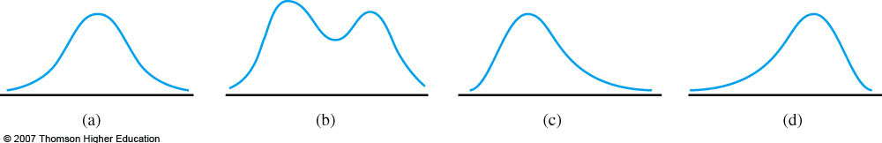
Histogram Shapes
Unimodal; symmetric; normal
Bimodal (also discuss multimodal)
Positively skewed – right tail is stretched out compared to the left tail
Negatively skewed – left tail is stretched out compared to the right tail

Slide 17
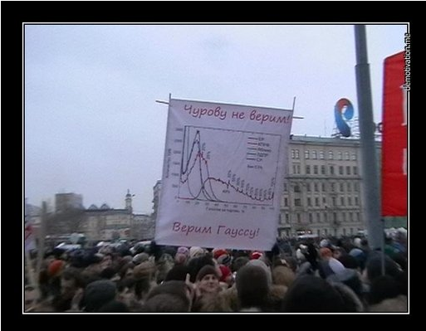
Election Protesters in Russia: We Do Not Believe Churov – We Believe Gauss!
Churov: Mastermind behind election rigging; Gauss: Father of the Normal Distribution.

Slide 18
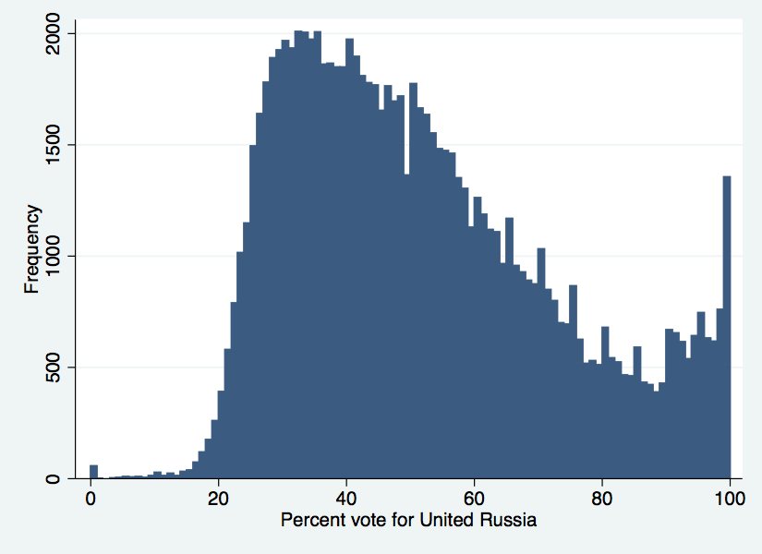
Alleged Voter Fraud in Russia: Examination of the Histogram
Frequency: # of precincts with a given % voting for Putin’s United Russia Party.
Notice peaks at percentages > 50% that are divisible by 5, and dips at 49%, 59%, 64% (1% less than 50%, 60% and 65%).
50%
65%
100%
70%
75%
80%
Source: http://themonkeycage.org/blog/2012/01/27/electoral-fraud-in-russia-report-from-the-russian-blogosphere/; http://samarcandanalytics.com/wp-content/uploads/2011/12/FineHistInset_large.png
Notes:
There are many more precincts where 65% vote for Putin than 64% or 66%; there are many more precincts where 70% vote for Putin than 69% or 71%.

Slide 19
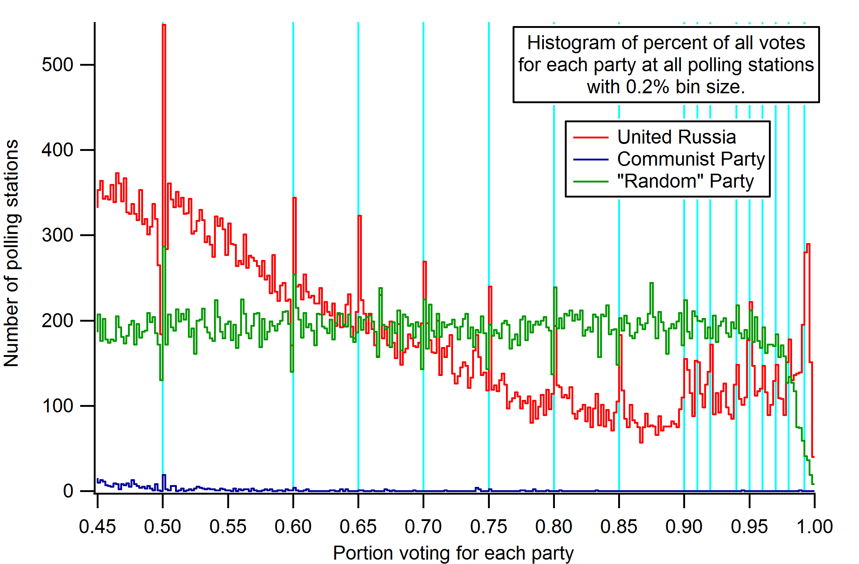

Slide 20
Data Collection (Continued)
The letters n (and sometimes m) generally represent the number of observations in a dataset
Capital letters like X, Y, or Z are used to represent the names of variables
Lower case letters like x, y and z stand for the data values
The values in the order that they were collected or sorted, are indicated by subscripts – for instance, x1, x2,…, xn.
n=4 | Y (name) | X (age) | Person # (i) | X_{i}
 | Bob | 5 | 1 | x₁ = 5
 | Jane | 3 | 2 | x₂ = 3
 | Kate | 6 | 3 | x₃ = 6
 | Bill | 10 | 4 | x₄ = 10

Slide 21
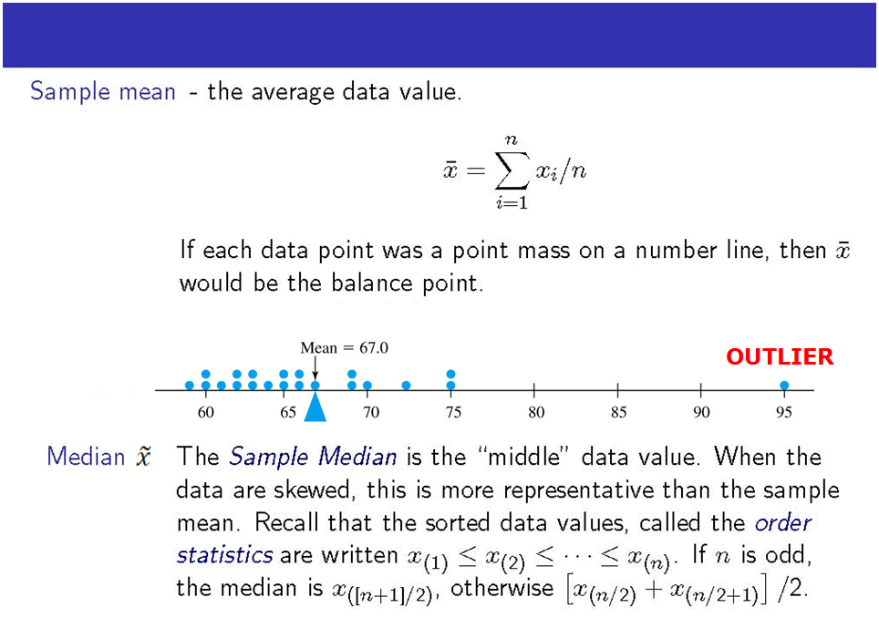
Measures of Location

Slide 22
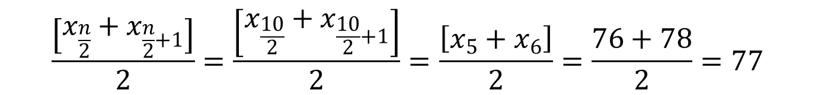
Example
In a class of n=10 people, we have the following test scores:
80 97 83 43 75 58 67 78 34 100
Mean = (80+97+83+43+75+58+67+78+34+100)/10=71.6
Median:
Put values in ascending order:
x1…x10 = 34, 43, 58, 67, 76, 78, 80, 83, 97, 100
Because we have an even number of observations (n=10), the median is the mean of the two middle numbers (76 and 78), which is 77.
General notes: Mean is influenced by outliers. Median is not.

Slide 23
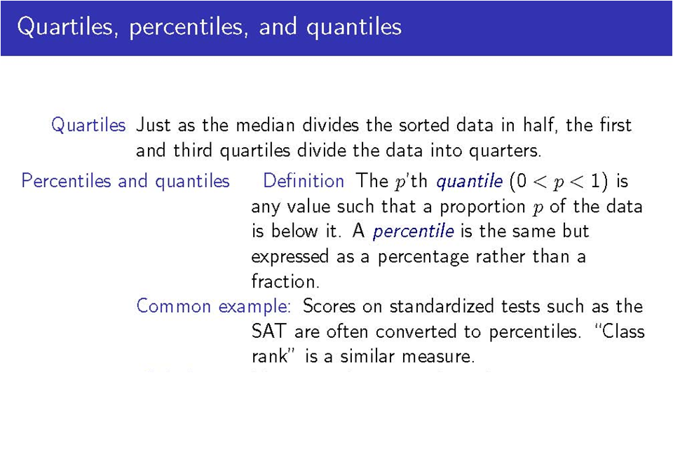
1st Quartile corresponds to 25th Percentile. 50th Percentile = 2nd Quartile = Median. 99th percentile on a test means you did better than 99%
Notes:
1st quartile: midpoint between minimum value and median; 3rd quartile: midpoint between maximum value and median.

Slide 24
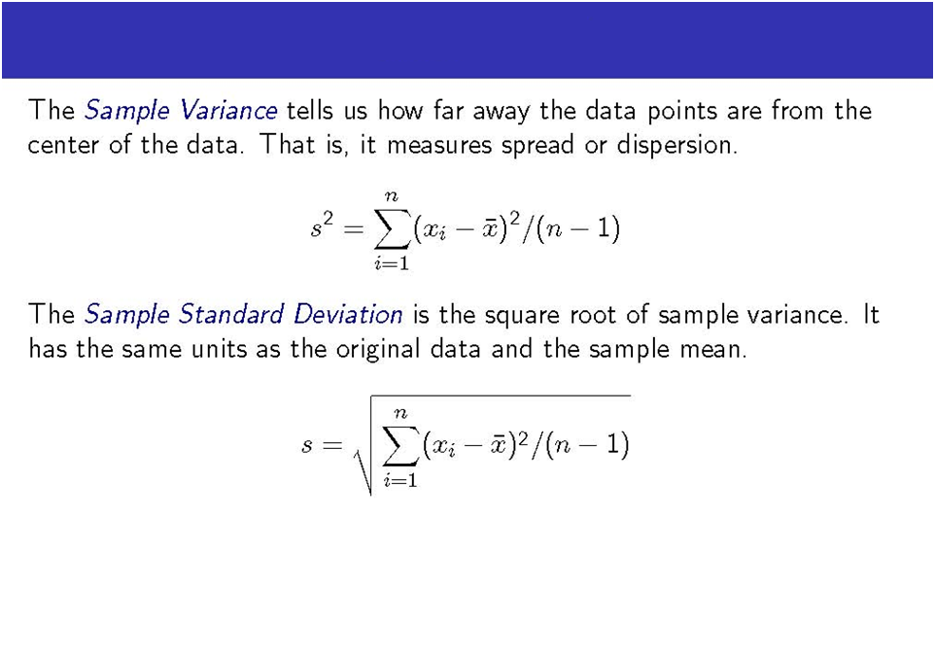
1.4 Sample Variance and Standard Deviation
Points for Discussion:
1. Measurement Units of Variance and SD.
2. Why do we square the term inside the summation sign?
3. Why do we divide by n-1 and not n? See: http://blog.guiguan.net/2007/05/why-divide-by-1-and-not-n/

Slide 25
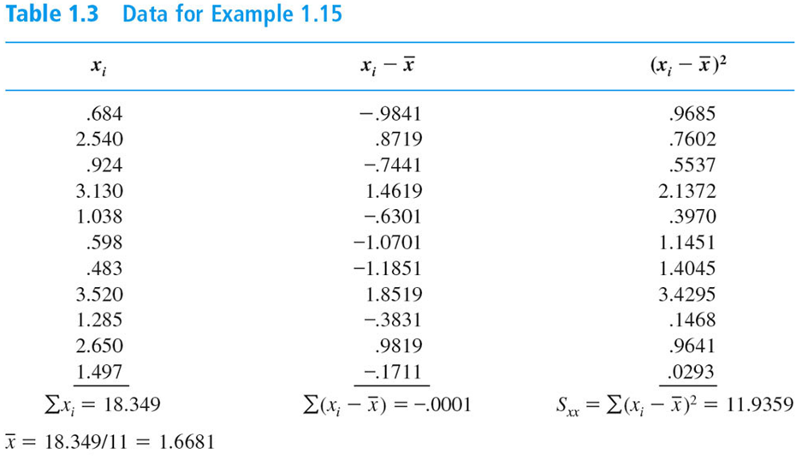
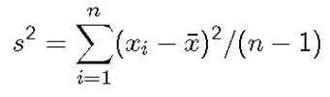
Standard Deviation Calculation - Example
= 11.9359/(11-1) = 11.9359/10 = 1.194
Notes:
How long, in minutes, it takes to drive a 0.5 mile segment of a highway in LA at different times and during various traffic conditions.

Slide 26
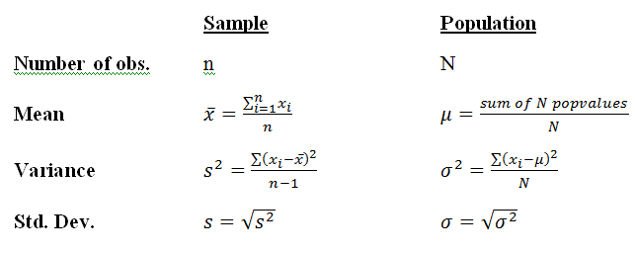

Sample vs. Population Mean and Variance
Again, rarely do we have data on the entire population, so we often make inferences about the population from the sample
The sample mean $\overline{x}$ is used to make inferences about the population mean µ.
Likewise, the sample variance s² is used to make inferences about the population variance σ².

Slide 27

A Crash Course on Statistical Inference

Slide 28

Relationship Between Probability and Statistics
With the male to female ratio in the MUSA program being 3:2, what is the probability of drawing a random sample of 6 MUSA students where the ratio is 2:3? (Knowing the property of the population, what is the probability of getting a certain sample?)
- Deductive reasoning
Knowing that the average score on the stats midterm in a class of 8 CPLN students was 90, what can you say from that data about the average score of the overall CPLN population? (Knowing something about a sample, make inference about the population)
- Inductive reasoning
Notes:
In a 52 deck card, what’s the probability that the next two randomly drawn cards will be spades?

Slide 29

Relationship Between Probability and Statistics
Source: www.causeweb.org

Slide 30
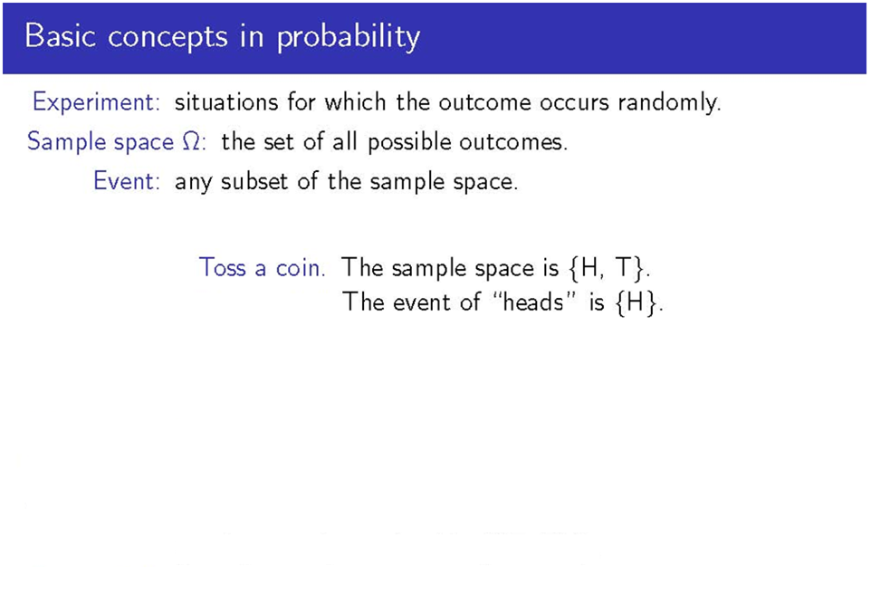
Notes:
Pass, fail;
Clubs, spades, diamonds, and hearts

Slide 31
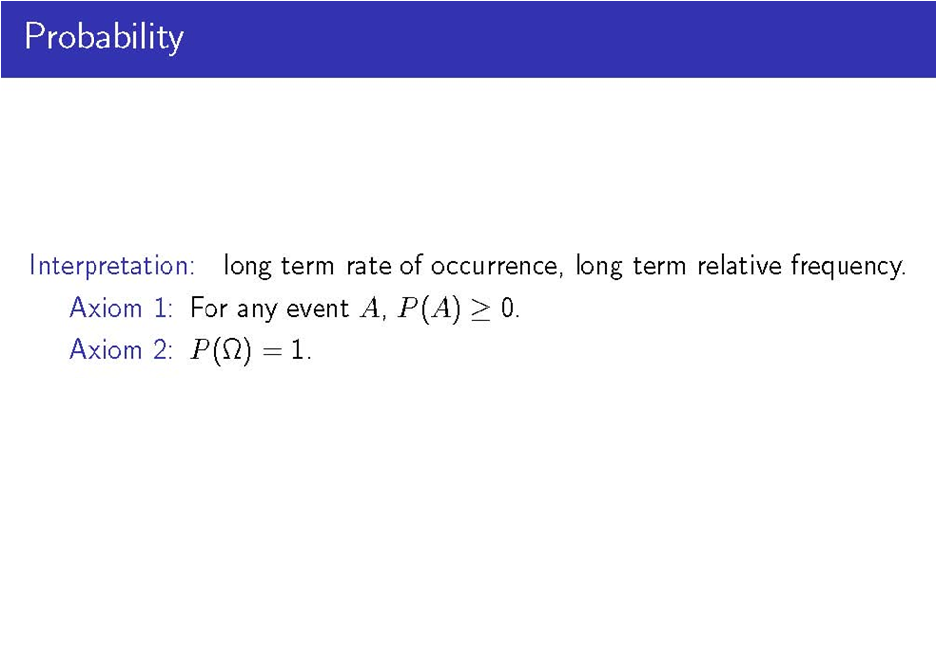
Given an experiment and a sample space Ω, the objective of probability is to assign to each event A some number P(A), called the probability of the event A, which will give a precise measure of the chance that A will occur.

Slide 32
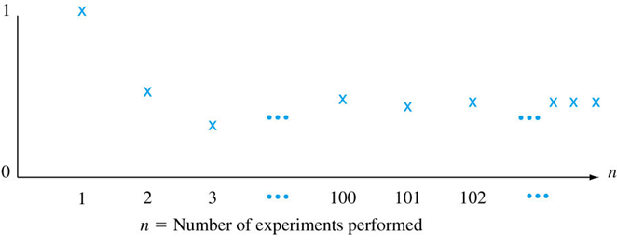
Illustration
Assume we have an experiment where we toss a coin.
The sample space is Ω={Heads, Tails}.
P(Ω)=1 according to Axiom 2: this is logical, because if we toss a coin, we are guaranteed that we will get either a heads or a tails. So here, the probability of getting either a heads or a tails is 1=P(Ω)=P(Heads)+P(Tails)
Assume we have a fair coin, and P(Heads) = P(Tails) = 0.5. This means that when we repeat the experiment many times, we will get heads half the time and tails half the time.
In the figure below, let n(heads) denote the number of times that heads occur when a coin is tossed n times. The ratio n(heads)/n is then the relative frequency of occurrence of heads in a sequence of n replications.
As n gets arbitrarily large, the relative frequency stabilizes, approaching a limiting value (here, 0.5), which we call the limiting relative frequency of the event. We can interpret probability as this limiting frequency
$$\frac{n(heads)}{n}$$
Notes:
Assume we toss a fair coin 1 time. Assume we get heads. Then n(heads)/n = total number of heads/number of tosses = 1/1 = 1.
Assume we toss a fair coin the second time. Assume we get tails the second time around. Then n(heads)/n = ½.
Meteorology example: When a meteorologist says that the model shows that there’s 40% chance of rain…
\
Assume we toss a fair coin the third time. That third time, assume we get tails again. Then n(A)/n = 1/3.
When you toss a fair coin n times, where n is large. Then, n(A)/n will be approximately ½.

Slide 33
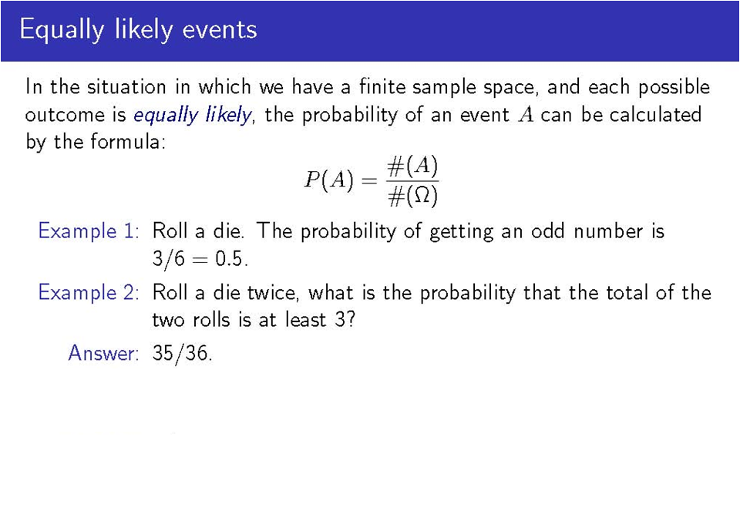
Number of outcomes in event = A divided by number of
outcomes in the sample space Ω
 |  | Roll 1
 |  | 1 | 2 | 3 | 4 | 5 | 6
Roll 2 | 1 | (1,1) | (1,2) | (1,3) | (1,4) | (1,5) | (1,6)
 | 2 | (2,1) | (2,2) | (2,3) | (2,4) | (2,5) | (2,6)
 | 3 | (3,1) | (3,2) | (3,3) | (3,4) | (3,5) | (3,6)
 | 4 | (4,1) | (4,2) | (4,3) | (4,4) | (4,5) | (4,6)
 | 5 | (5,1) | (5,2) | (5,3) | (5,4) | (5,5) | (5,6)
 | 6 | (6,1) | (6,2) | (6,3) | (6,4) | (6,5) | (6,6)

Slide 34
Conditional Probability
The probability of event A calculated given some information B, is called conditional probability, and is denoted by P(A|B).
For instance, if event A is voting for Clinton and event B is living in PA, then…
P(A|B) is the probability of voting for Clinton given you live in PA.
AND
P(B|A) is the probability of living in PA given that the vote was cast for Clinton

Slide 35
Independent Events
Two events, A and B, are independent iff:
P(A|B) = P(A) and P(B|A) = P(B)
or equivalently,
P(A and B) = P(A)*P(B) Note: (A and B) is usually denoted (A ᴖ B)
Example:
In the previous example, where A is event of voting for Clinton and B is the event of
living in PA, if A and B are independent, then
P(Voting for Clinton | Living in PA) = P(Voting for Clinton), and
P(Living in PA| Voting for Clinton) = P(Living in PA)
That is, whether A occurs has no influence on whether B occurs, and vice versa.
As an aside, we will see later in the course that independence is a vital assumption of many statistical tests. But more on that later…

Slide 36
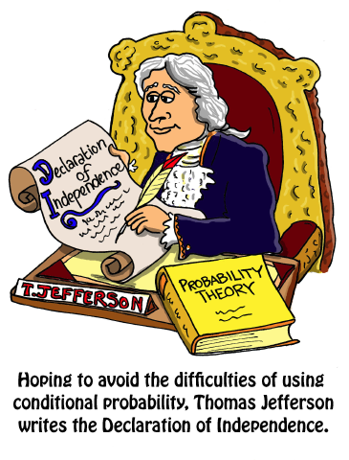
Conditional Probability
Source: www.causeweb.org

Slide 37
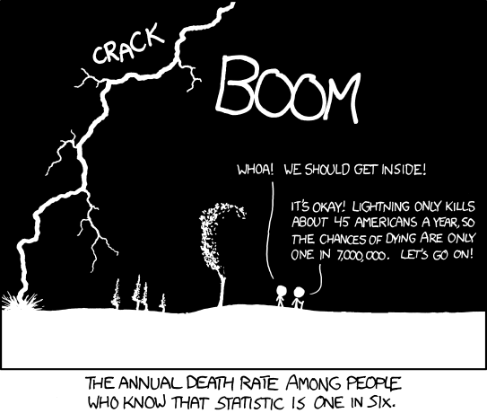
Conditional Probability
Source: www.causeweb.org

